Slide 1
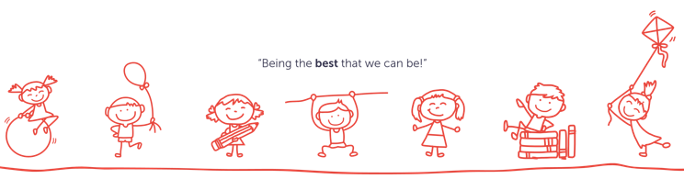
Welcome to
Bracebridge Infant and Nursery School

Slide 2
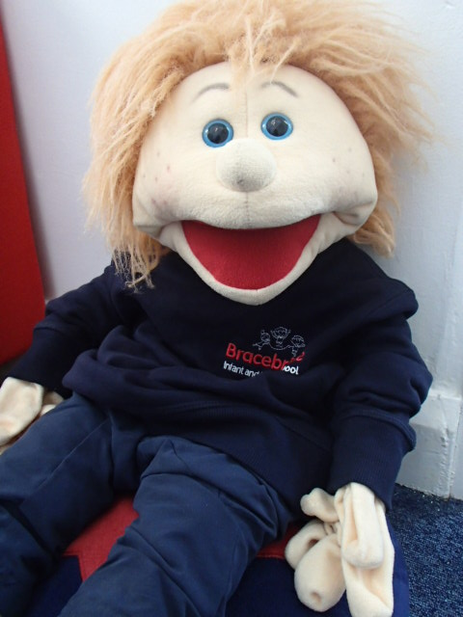
Hello!
My name is Louie and I go to Bracebridge Infant and Nursery School. I hear that you are starting school in September. I have made this book to show you all the exciting things that you can see and do when you start school. Can you find me in the photographs?
I can’t wait to meet you.
Love Louie xxx

Slide 3
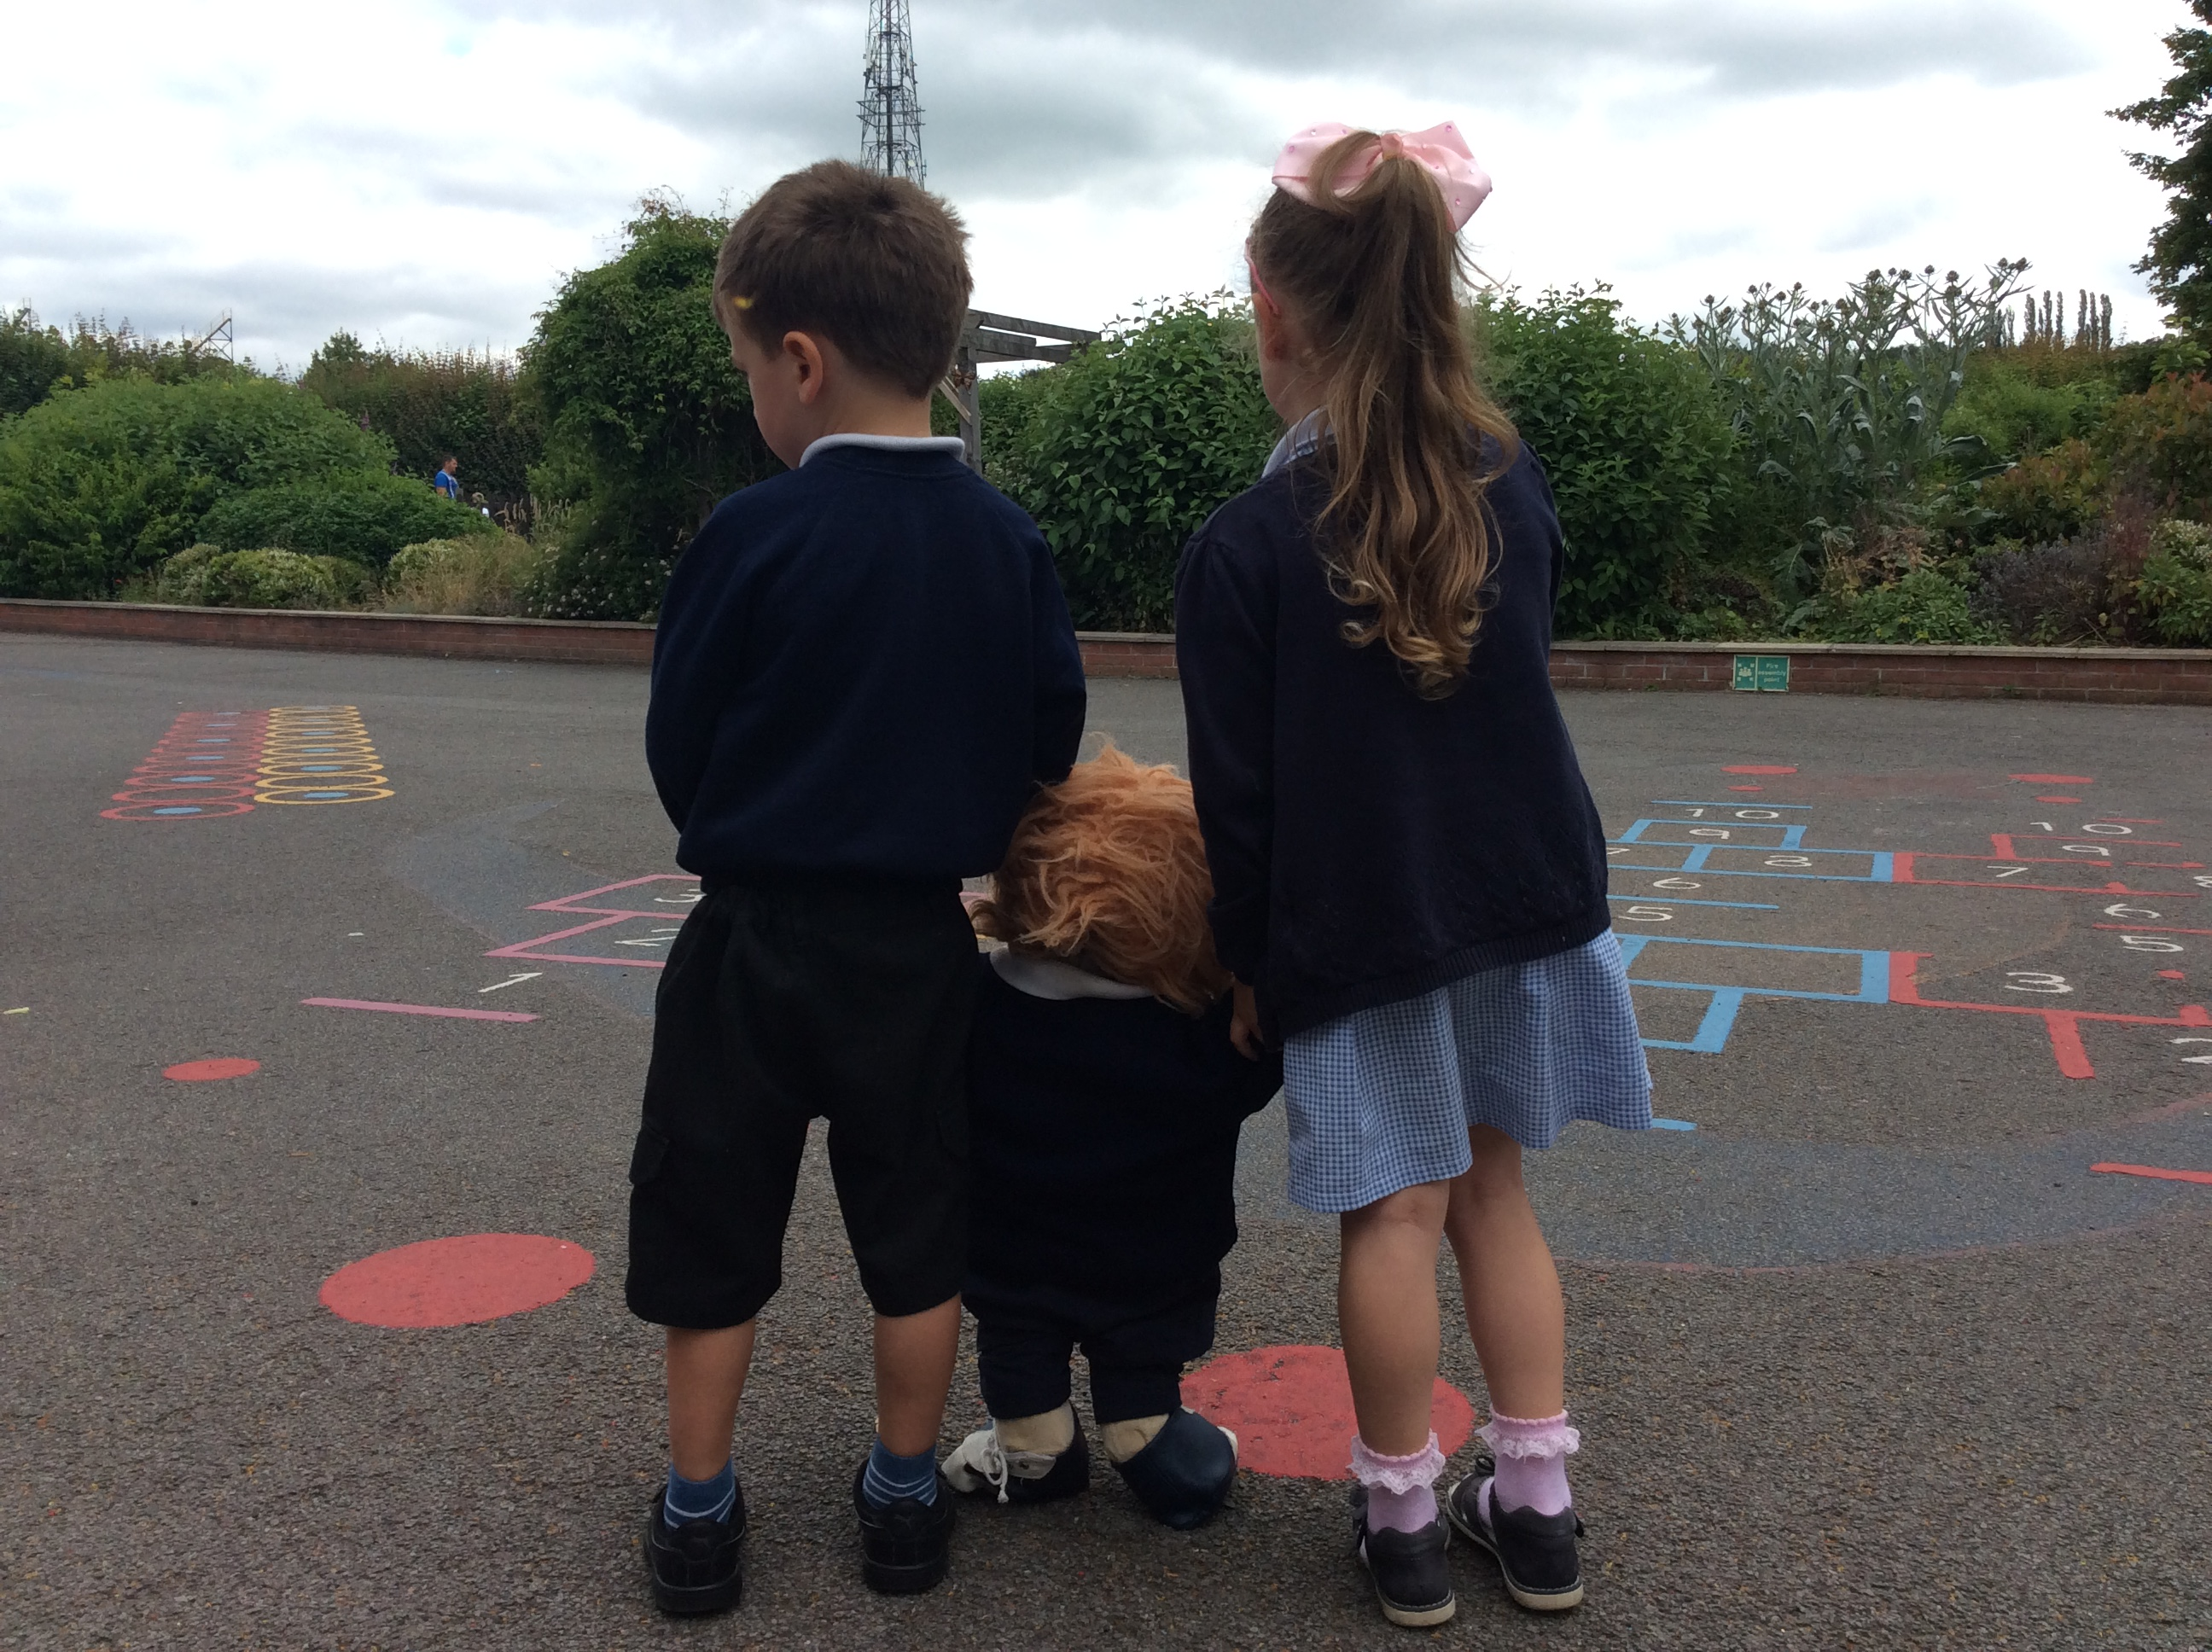
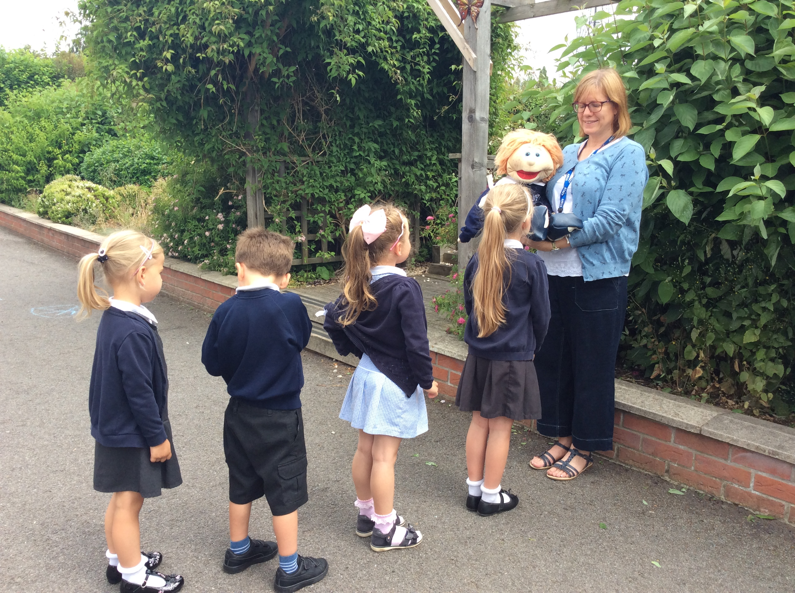
Before school starts you will need to wait on the playground for your teacher. When the bell rings you can say goodbye to your grown up and line up with your teacher.

Slide 4
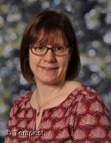
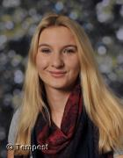
The grown-ups will welcome you to school with a big smile. Let’s meet some of the adults who are in your class.
Name - Mrs Ashberry
Job - Class Teacher
Favourite Food – Lasagne
Favourite Colour - Blue
Name - Miss Stephenson
Job – Teaching Assistant
Favourite Food – Chocolate
Favourite Colour - Purple

Slide 5
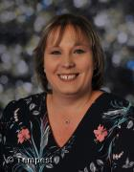
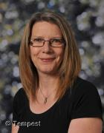
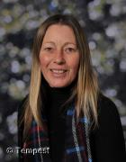
Here are some of the other adults you will meet at school.
Hello, my name is Mrs Wilson and I am the headteacher.
Hello, my name is Mrs Rice and I will look after you if you fall over on the playground.
Hello, my name is Mrs Atkinson and I will look after you at lunch time.

Slide 6
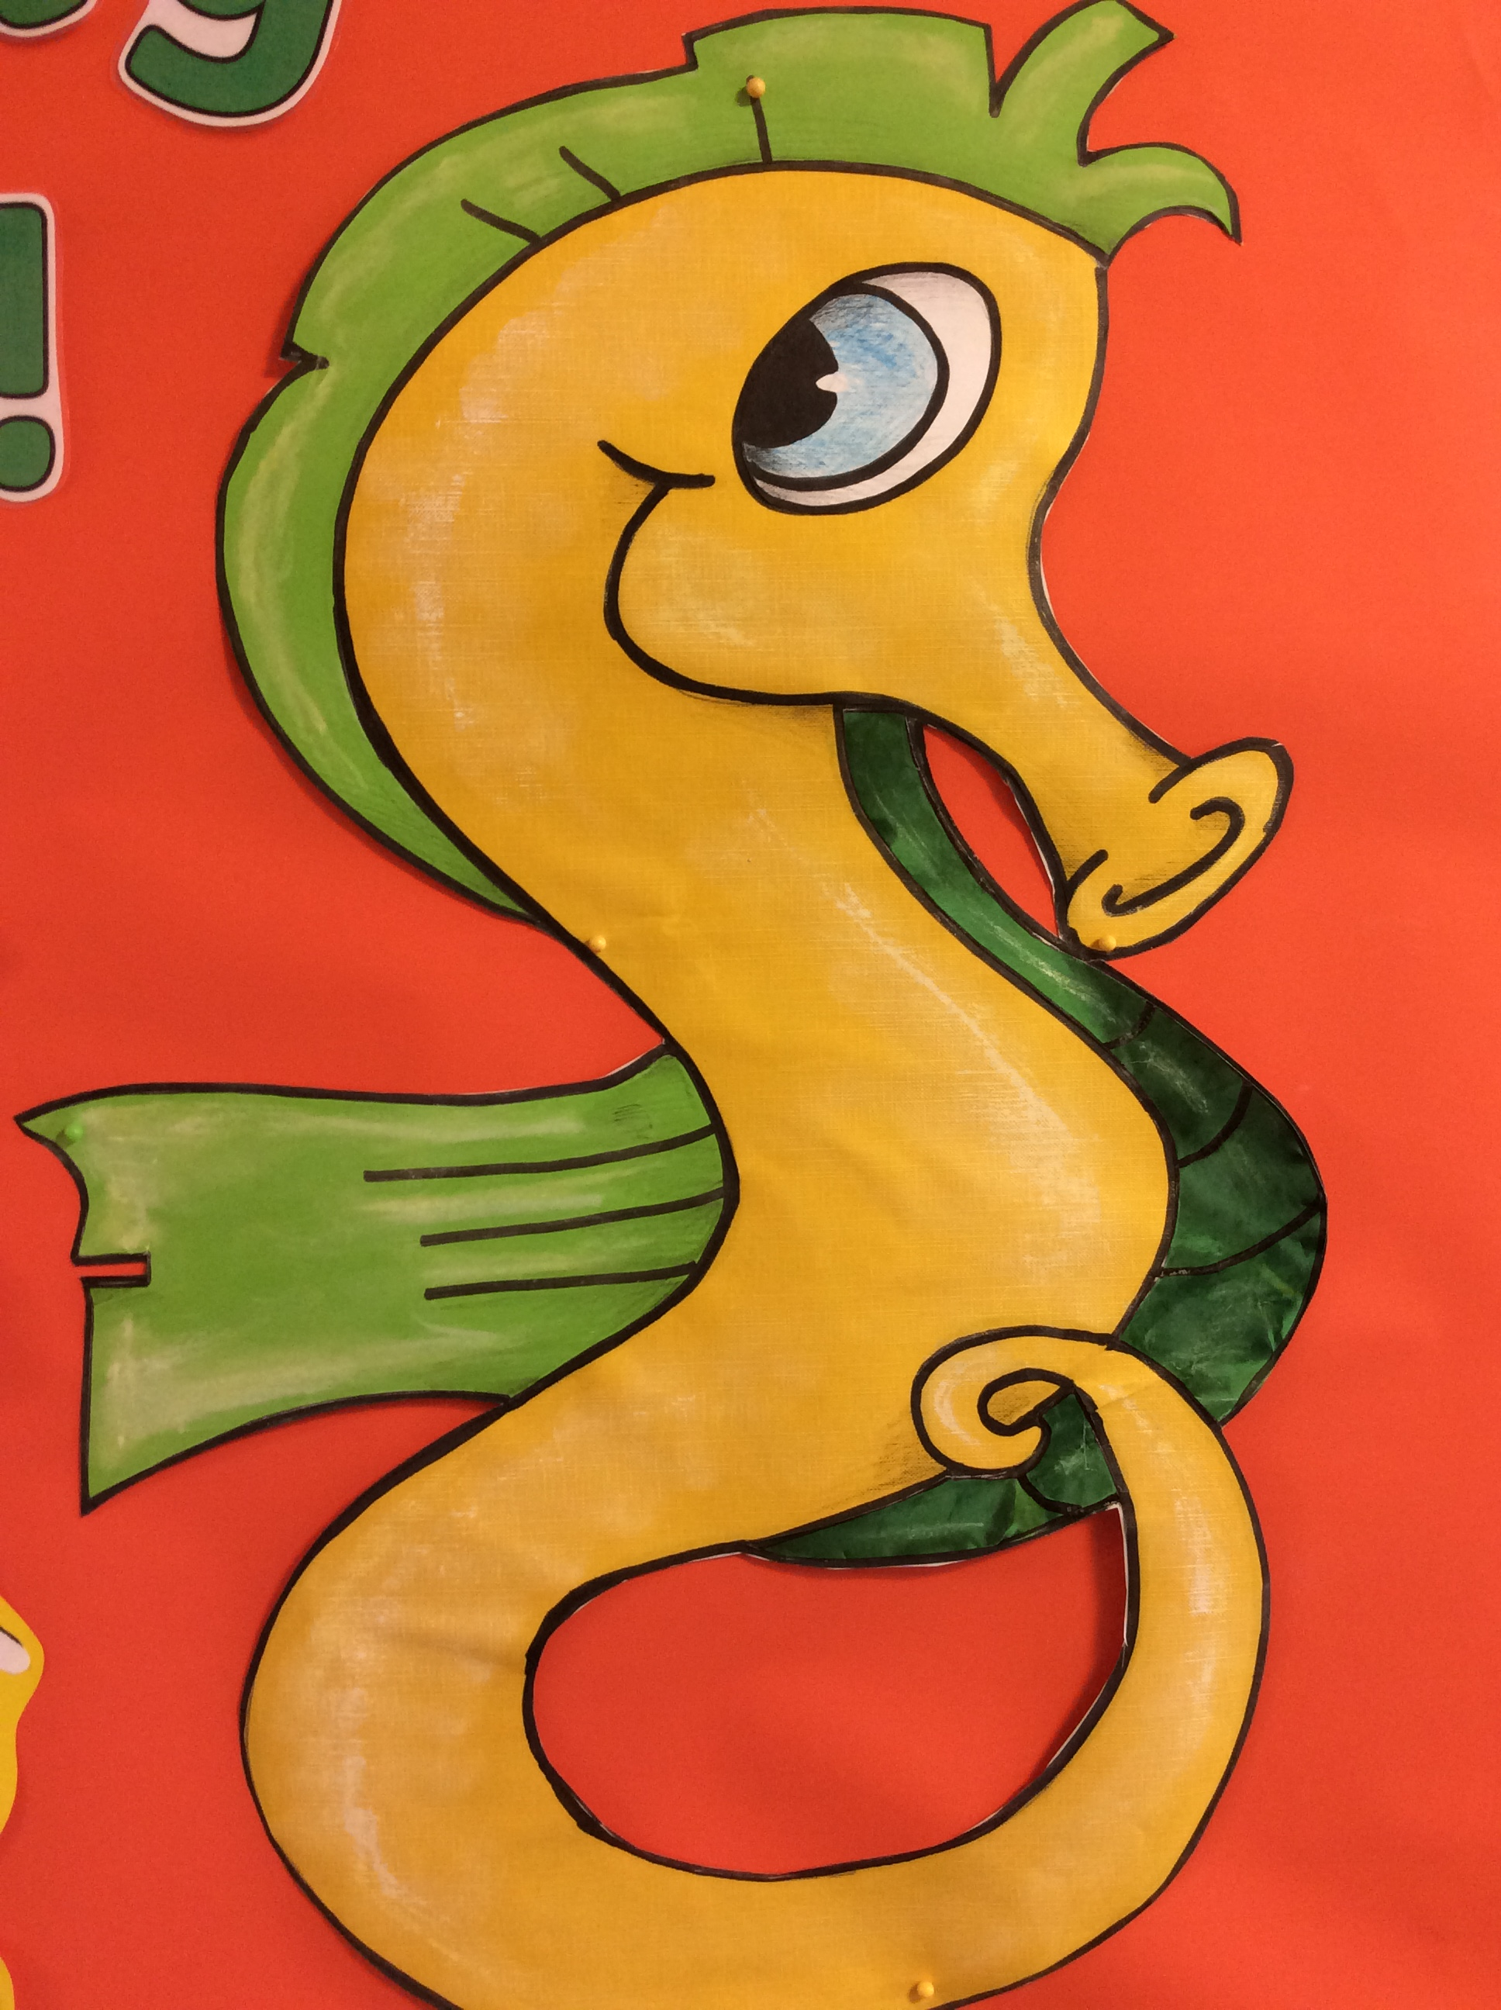
You will be in the Sparkling Seahorse Class.

Slide 7
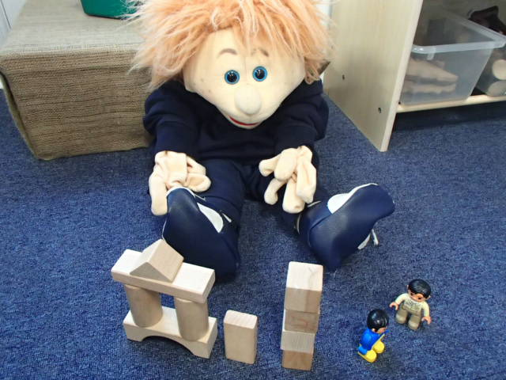
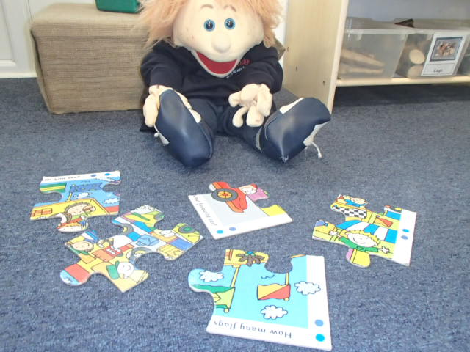
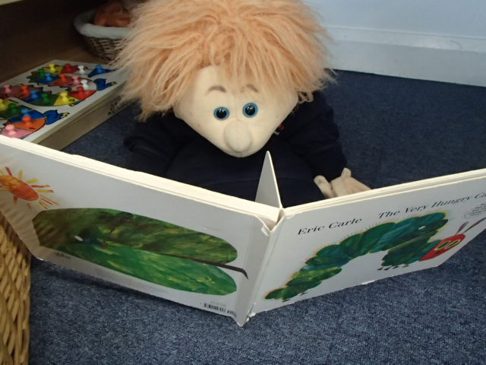
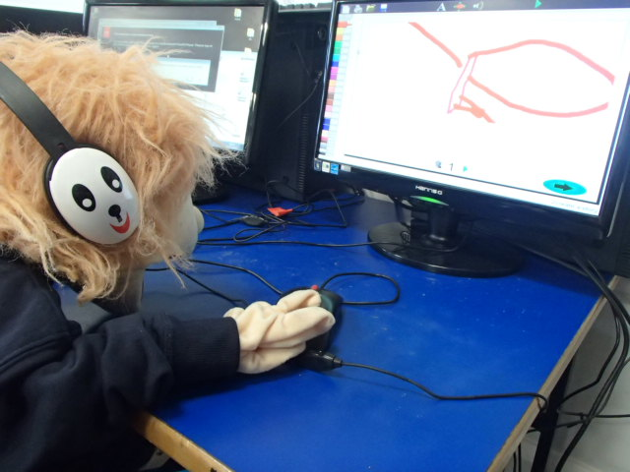
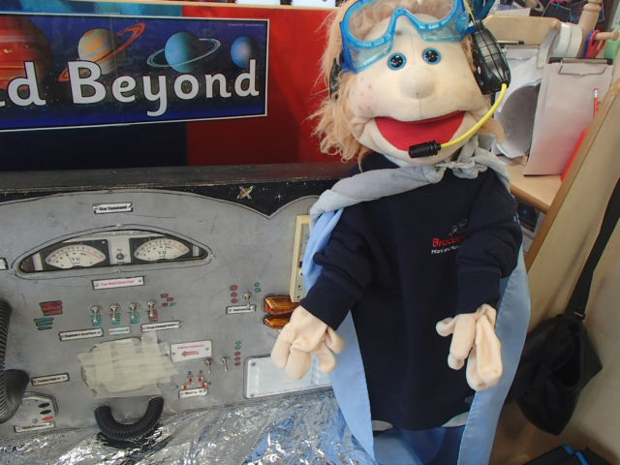
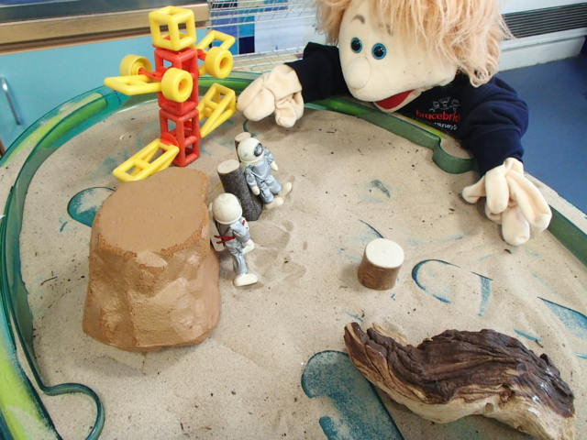
There are lots of fun things to do in the classroom. Here are some of my favourite activities. What do like to do?

Slide 8
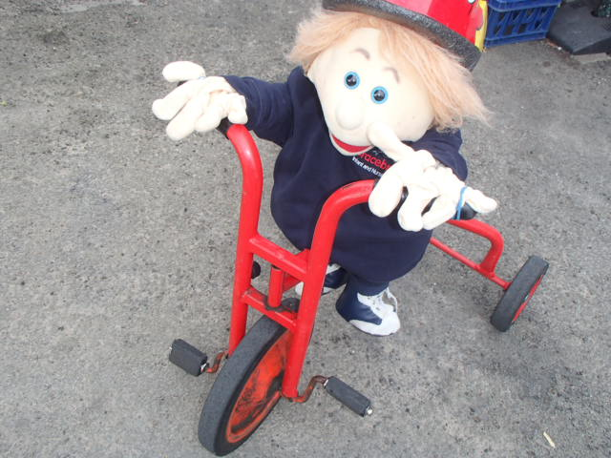
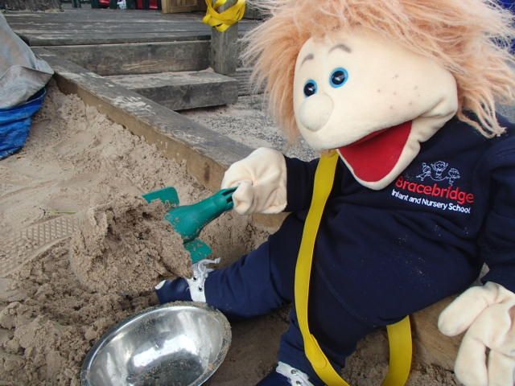
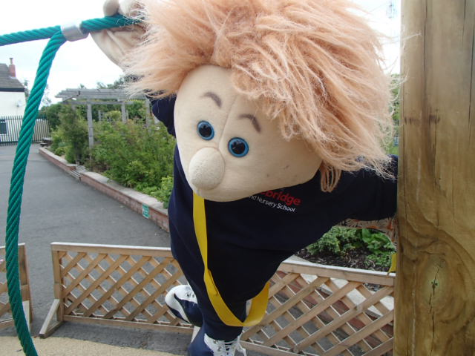
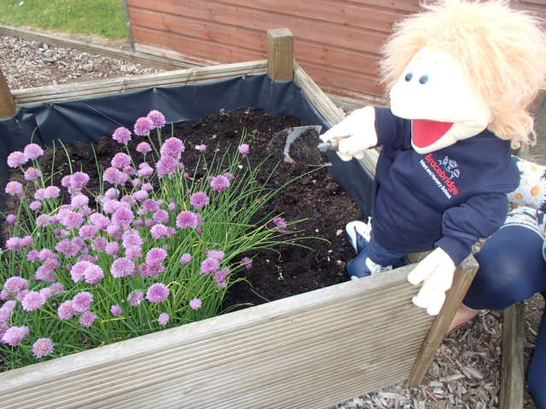
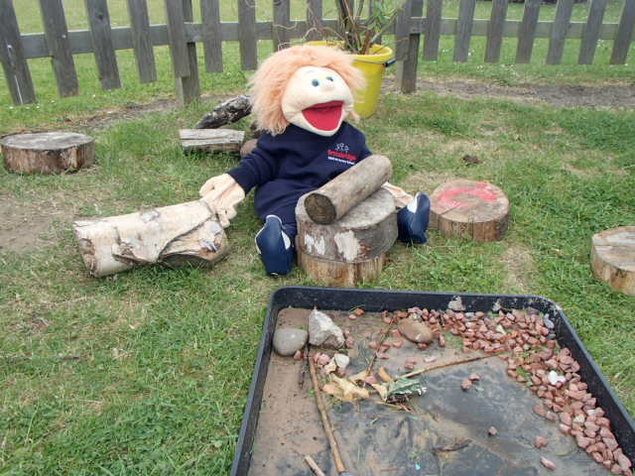
There are lots of fun things to do outside too!

Slide 9
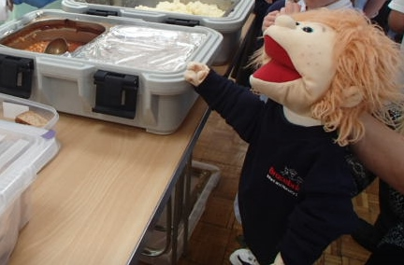
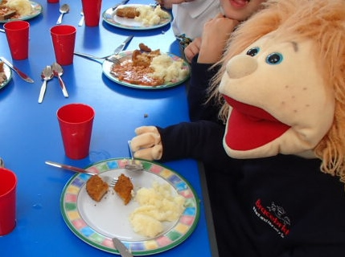
You will stay at school all day. At lunch time you will sit in the hall with all the other children. You can have a school dinner or bring your own packed lunch.

Slide 10
We hope that you have enjoyed reading about your new school. We can’t wait to meet you soon!

