Slide 1
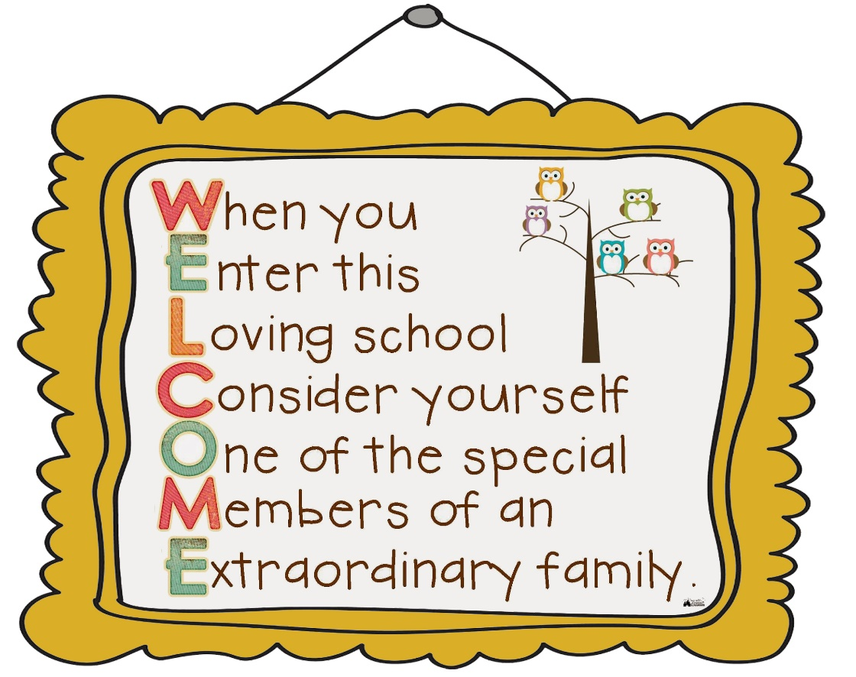
Welcome to

Slide 2

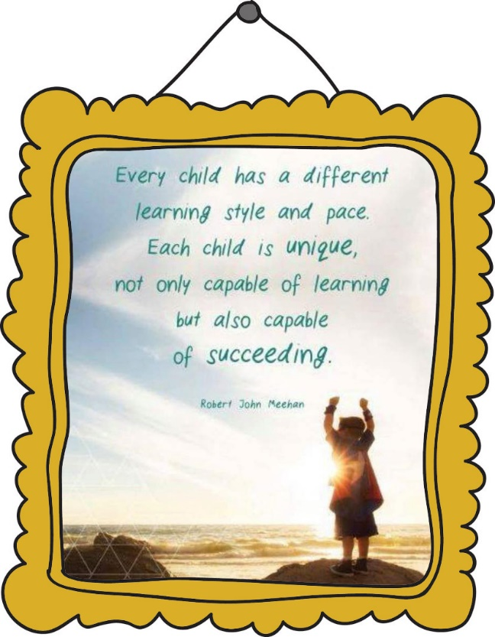
“Being the best that we can be!”
The EYFS at Bracebridge is for children aged three to five years old (Nursery/Reception) and is the first stage of their education. The key focus during this part of their learning is on teaching them routine and easing them into the idea of learning in a structured environment. A lot of the activities your child will undertake will be play-based, with more formal teaching not starting until they begin Key Stage 1 (Year 1 and Year 2).
The EYFS Framework sets out the learning and development stages for children as they grow from birth to five years. For those working in the early years - whether in a nursery, pre-school, a childminder or in a reception class in school - the EYFS framework outlines what they need to do to support your child.

Slide 3

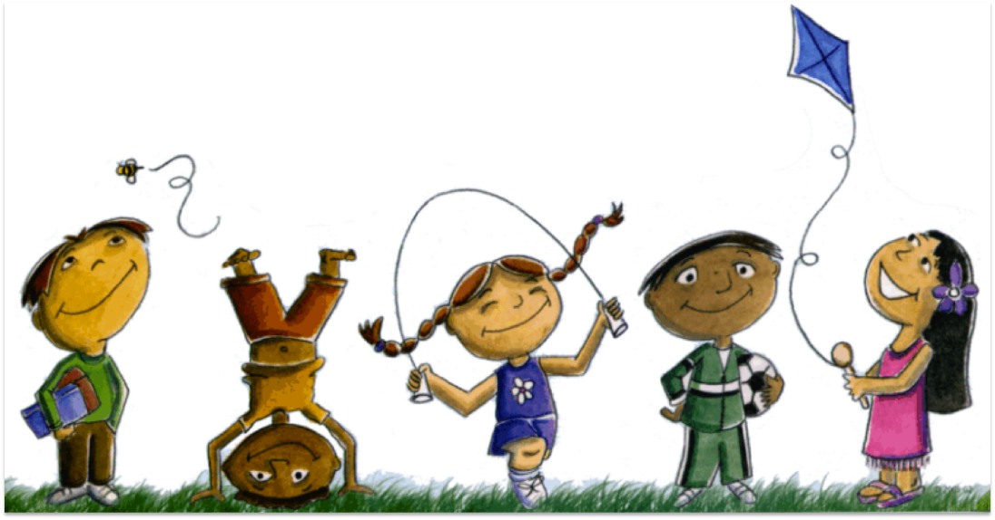
“Being the best that we can be!”
In reception, your child will continue to learn by doing things for themselves, by exploring and investigating, watching and listening, talking and discussing, creating and communicating — in other words — playing. Play is children’s work and playing hard is very tiring! Your child may be really exhausted and perhaps a bit grumpy when they come home! If they don’t want to talk about their day straight away, don’t worry, they will gradually let you into their new world as time goes by. Play can also be very messy as your child will be learning both inside the classroom with sand, water, paint, but also in the outdoors with mud, leaves etc. so you can expect some mucky clothes at the end of the day!

Slide 4

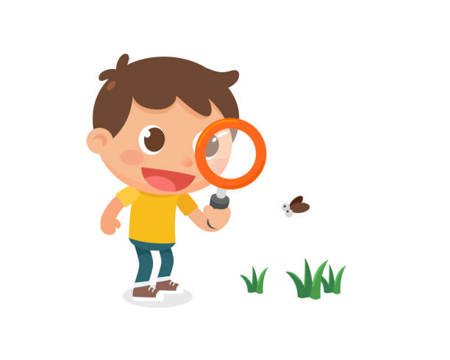
“Being the best that we can be!”
Children learn and develop through playing, exploring, being active, creative and being asked questions to help their thinking. There are seven learning areas for children at the Foundation Stage:
Personal, social, and emotional development
Communication and language
Physical development
Literacy
Mathematical development
Knowledge and understanding of the world
Creative development
These areas of learning are split into two categories, Prime and Specific.

Slide 5

“Being the best that we can be!”
Personal, social and emotional development
One of the prime aspects of your child’s first year at school will be a focus on their personal, social and emotional development, and their teacher will be aiming to give them a good start to their school experience by helping them form positive relationships, build confidence and self-awareness, as well as regulate their feelings and behaviour and to understand how to look after themselves and be healthy.
Physical development
Physical development is important too: you will hopefully notice that they are starting to move more confidently in both their gross and fine motor skills.
Communication
The final prime is communication. Children learn through speaking and listening first and foremost, and this year you may notice your child communicating in a variety of ways at school — for example, through stories, in conversations with adults and their friends, or through facial expression, movement or dance.
To find out more about the EYFS, please visit https://foundationyears.org.uk/2019/09/resources-for-parents/

Slide 6

“Being the best that we can be!”
Literacy
For the specific areas of learning, your child will learn the basics of literacy — reading, writing and phonics. We follow a scheme called Read Write Inc. Don’t worry — the scheme progresses gradually, and you will be given lots of helpful advice and support along the way! As well as being invited to a parent workshop during the autumn term.
Mathematics
Maths learning in Reception covers numbers, patterns, simple sums, shapes, spaces and simple measuring.
Understanding the World
Children learn about the world, exploring different people and communities, and the past and present.
Expressive Arts and Design
Imagination and creativity are championed in the area of expressive arts. Your child will explore different media and materials and be encouraged to use their imagination in a range of different experiences.
To find out more about the EYFS, please visit https://foundationyears.org.uk/2019/09/resources-for-parents/

Slide 7


“Being the best that we can be!”
Children are assessed at the Foundation Stage and the results are recorded as a Foundation Stage Profile. This profile enables teachers to see how your child has progressed and if they have reached the early learning goals set in each of the learning areas. Teachers will record your child's achievements throughout the Reception year based on their own observations.
In September 2020, the Government introduced a reception baseline assessment as well. The reception baseline assessment provides the basis for a new way of measuring the progress primary schools make with their pupils. This assessment will take part in the first six weeks of your child starting in reception.
The assessment involves practical tasks and is carried out by your child’s teacher.

Slide 8

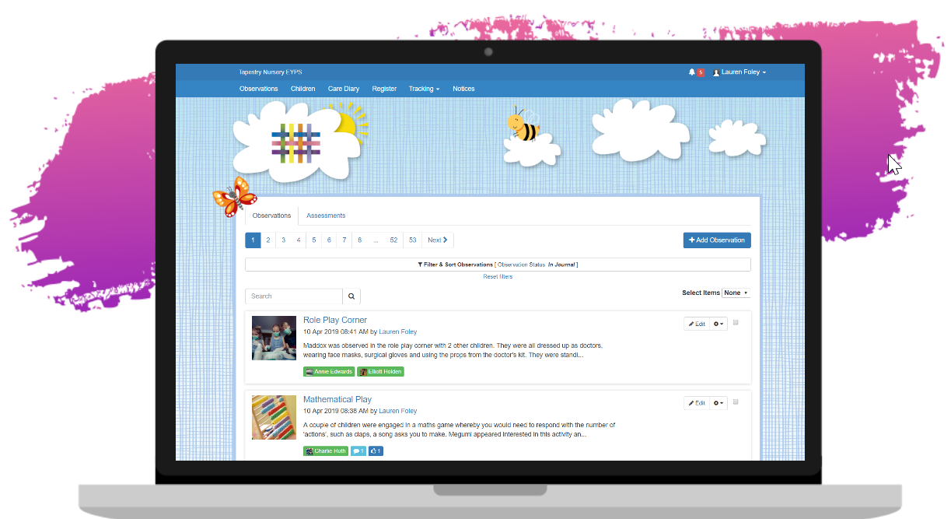

“Being the best that we can be!”
In school we record your child’s learning using Tapestry, books and the teacher’s knowledge of your child.
Tapestry is an online journal recording all the learning and fun of children’s early years education.
Both teachers and parents are able to record, track and celebrate children’s progress in the early years. You will be given access to this once your child has started in school. If you are unfamiliar with how to use Tapestry your child’s teacher will be able to show you how to view and comment on observations as well as how to add your own.

Slide 9

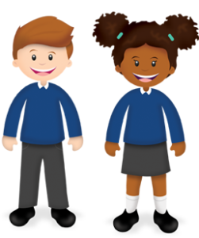
“Being the best that we can be!”
Please visit https://www.uniform-direct.com/index.html for uniform items with our logo.
Please clearly label all parts of your child’s uniform and PE kit, this includes shoes, trainers, bags and coats.

Slide 10


“Being the best that we can be!”
Every day your child will need to bring:
A book bag
A named drink bottle containing water
A coat
A change of clothes
Their reading record and reading book
PE kit
Please clearly label all parts of your child’s uniform, including PE kit, shoes, trainers, bags, coats, wellies, water bottles and lunchboxes.

Slide 11


“Being the best that we can be!”
Children in EYFS and Key Stage 1 (year 1 and 2) are entitled to free school meals. These are provided by Kidz Kitchen. You will be given information about how to access their online ordering system to enable you to choose your child’s meals each day.
We do encourage you and your child to take advantage of this free service, however, you can choose to send your child in with a healthy packed lunch instead. This should be sent in a named lunch box.
Children are also given a healthy snack and milk during the day.
Please visit https://kidzkitchen.co.uk/ for more information.

Slide 12

“Being the best that we can be!”
Reading is front and centre of everything that we offer to support your child’s learning. Selecting the right texts is vital to ensure that children have a broad and rich understanding of any theme. Each class has their ‘Favourite Five’ books that they share each term. The children vote for the books they enjoy and books are changed depending on their preference. These books are re-read to ensure children can become familiar with them.
Children will also bring home a library book each week. This is for you to share together at home to read for pleasure. These should be returned to school every Friday so they can choose another one to enjoy at home.
Children will also bring home a reading record and reading book. As they progress through the Read Write Inc. phonics program they will also bring home a paper reading book which matches the book they have been reading in their phonics lessons. Supporting your child to read with you EVERYDAY is the best support you can give them to help them progress in school and life.

Slide 13




“Being the best that we can be!”
Communication is really important for Reception children and their parents. Your child’s teacher will form a special relationship with your child and be a point of contact for you. Please keep them up to date with what your child is interested in at home so that they can try to incorporate your child’s interests into the planning.
As a school we will communicate important information with you online via Parent Hub, in your child’s book bag and reading record, verbally (after school or by appointment) and parents evenings.
If you have any worries or concerns do please let the staff know about them. By talking concerns through together everyone can benefit and learn more about your child.

Slide 14

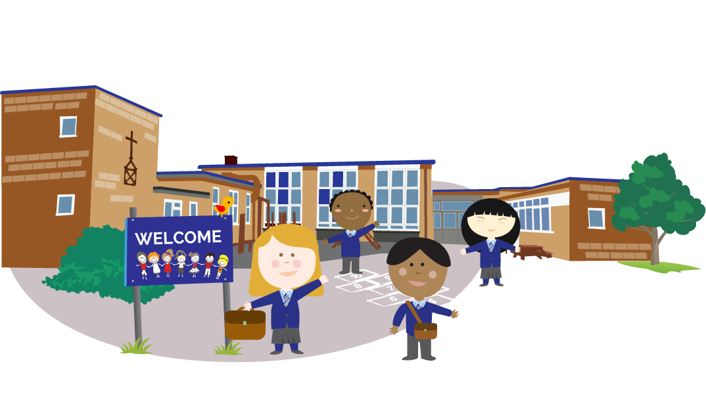
“Being the best that we can be!”
The school gates open at 8.45 am, with the register taken at 8.50am.
The school day ends at 3.20pm and the school gates are open from 3.15pm.

Slide 15

“Being the best that we can be!”
Read, read, read
Read with your child, read anything and everything! Real books, with pictures, rhyme and enjoyable stories are crucial here. Try to encourage your child to talk about the pictures, or to make predictions about what will happen next.
Encourage your child to recognise and read print when you are out shopping, on the bus or at the park.
Once your child starts school you will be asked to fill in a Reading Record each time you read with your child. This can be a really useful communication tool, so the more info you provide the better! The teachers are just wanting to find out about how things are going with your child’s reading and really don’t mind what you write so please don’t feel pressured at all here. It’s most important for your child to enjoy reading above all, so try to relax, and stop when either of you begins to feel pressured or anxious.
Help with phonics
Talk to your child about individual letters (especially the letters in their name) and their sounds. Singing songs and nursery rhymes really helps them to find out more about letters and sounds. Play I-spy when you go out (using the sound the letter makes, rather than its name).
Talk numbers
For maths, there are all sorts of ways to encourage number recognition. Try to involve your child in using numbers at home by singing number rhymes and songs or by encouraging them to recognise and read numbers when you are in the car. When making dinner, ask them to select the number of carrots or potatoes you need — they’re helping you out, and learning at the same time.
Getting dressed independently
It is really useful if you can encourage your child can have a go at dressing themselves at home so that they can do it themselves during the day. It’s often quite time-consuming for teachers to have to do up several zips on wriggly children bursting to go outside!

Slide 16

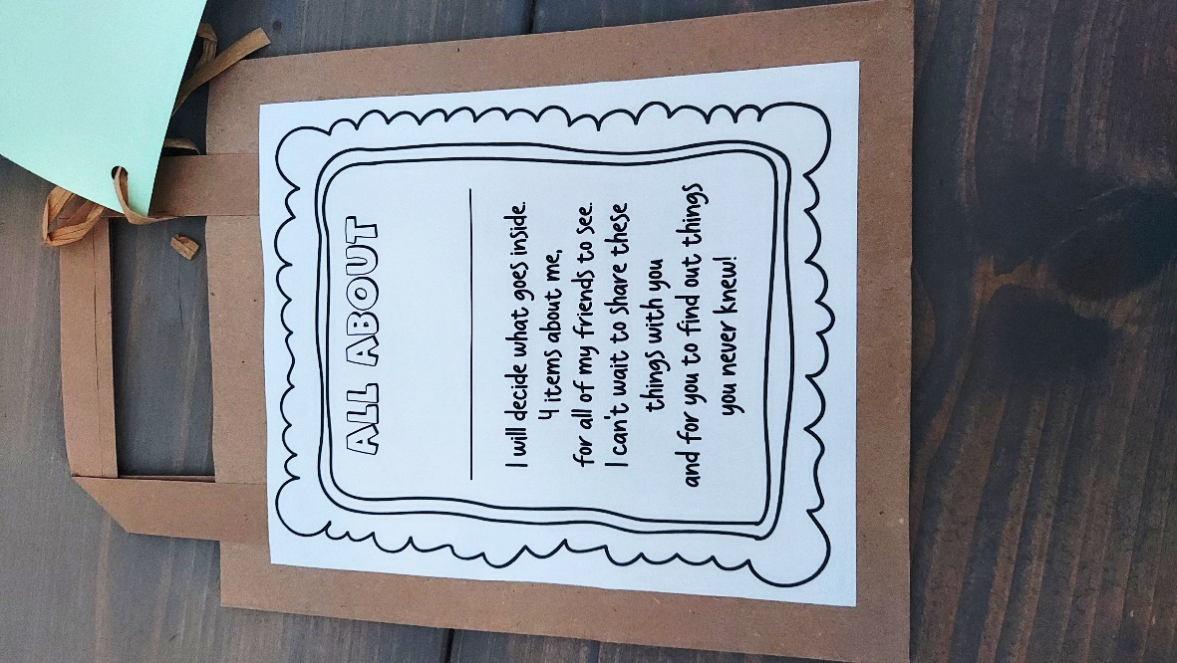
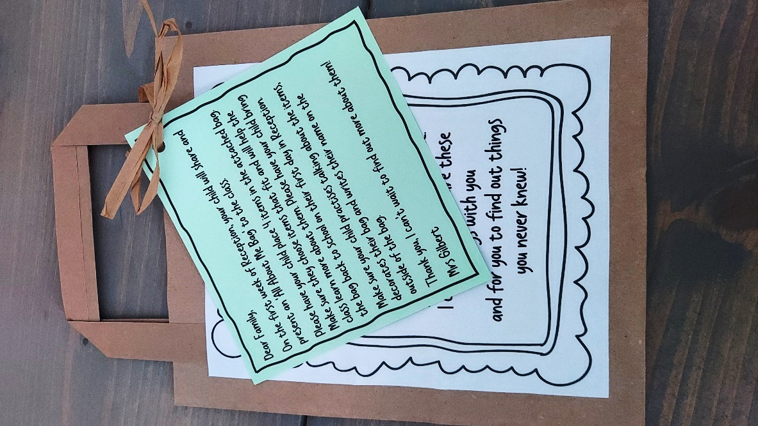
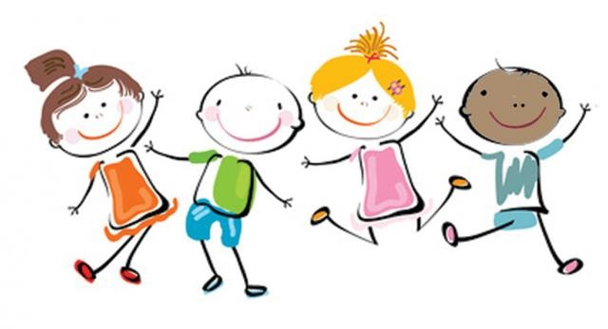
“Being the best that we can be!”
Over the summer holidays we would like you to complete an ‘All about Me’ bag with your child. This is to be shared with the class during their first week in Reception.

Slide 17


Finally…
Welcome to
Sparkling
Seahorses

